Slide 1
SDS 3386 FALL 2022 FINAL PROJECT PRESENTATION
By: Tamara, Elli, Coralie and Tanner

Slide 2




Introduction
Notes:
For the next around 25 years of our lives, most of us will spend a significant amount of hours working, and as human beings, it's in our nature to want to be happy right?
So the big question here is how can we be happiest at work? In other words, how can we be most satisfied with our jobs? That brings us to our main question... next slide

Slide 3
What are the main factors that influence job satisfaction?
Notes:
But what is job satisfaction? It is defined as a feeling of contentment or fulfillment in one's job. Are you happy in your work environment? Are you happy with the work you are doing? So how can we measure these factors? This can be measured by conducting surveys to find the level of importance of certain factors. The main factors we found in our reaseach were salary, environment, years per job level (advancement in their career), overtime work and sex.

Slide 4
A similar study: Evaluation of Factors Influencing Job Satisfaction
Most important
Atmosphere at work
Stability of employment
Good relations with co-workers
Good relations with superiors
Communication with management
A study by Barbara Sypniewska at the University of Finance and Management in Warsaw, Poland​
Least important
Communication with management
Content of work
Possibility of development
Sypniewska, Barbara, Evaluation of Factors Influencing Job Satisfaction (March 31, 2014). Contemporary Economics, Vol. 8, No. 1, pp. 57-72, 2014 , Available at SSRN: https://ssrn.com/abstract=2435040
Notes:
This study was conducted by Barbara Sypniewska at the uni of finance and management in warsaw, poland. It was conducted on a sample of 215 people in 2012. She found that the most important factors are the atmosphere at work, stability of employment, etc. And the least important are communication with managemnt, content of work and possibility of development

Slide 5
Two other studies:
Is salary the most important factor?
9 Out of 10 People Are Willing to Earn Less Money to Do More-Meaningful Work (hbr.org)
Are remote workers more satisfied?
Survey: On average, remote workers are about 20% happier | HR Dive
Notes:
Here are two of the studies we mentioned in our proposal. We found a first article that states most people are willing to earn less money to do more meaningful work which implies that salary is not the most important factor.
The second one is a study that found remote workers are happier than on-site workers...
Now Tanner and Tamara will present you with our results. Tanner....

Slide 6
Modeling IBM data

Slide 7
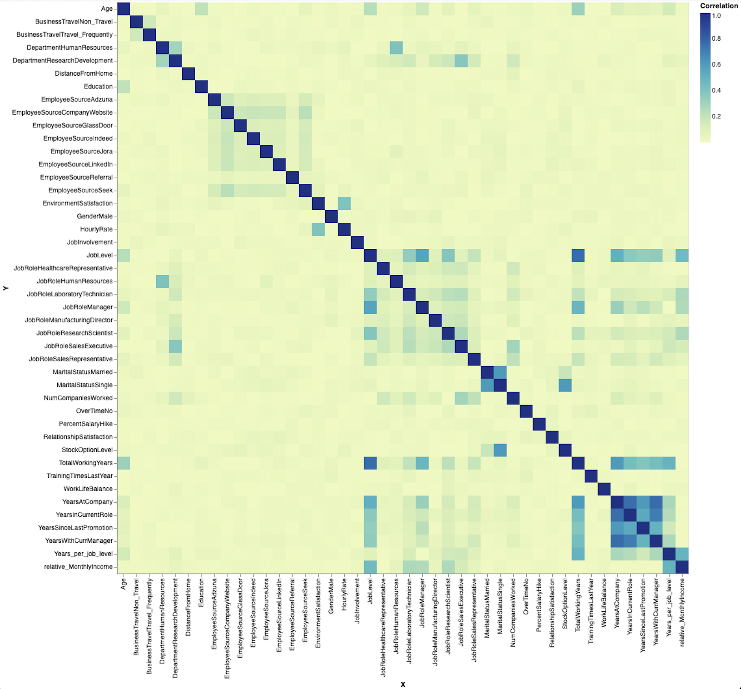
Correlation table

Slide 8
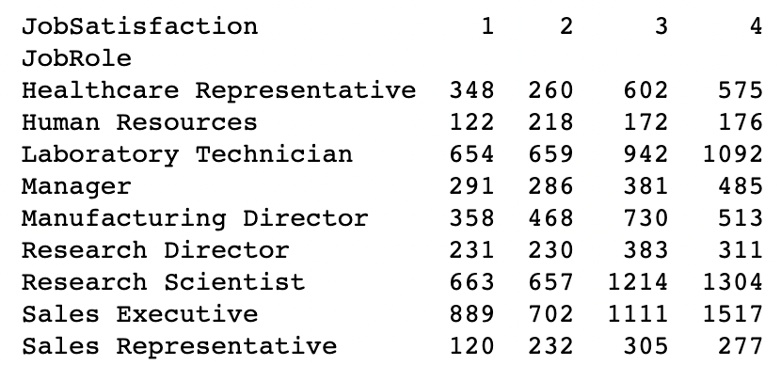
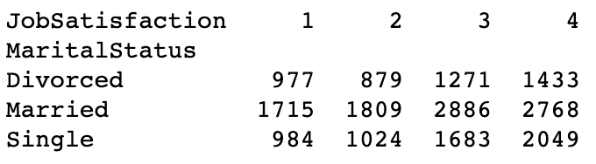
Contingency Tables

Slide 9
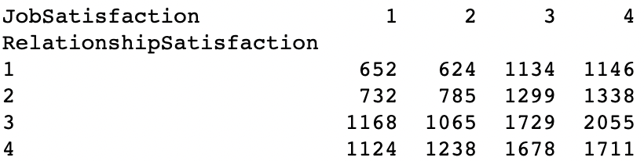
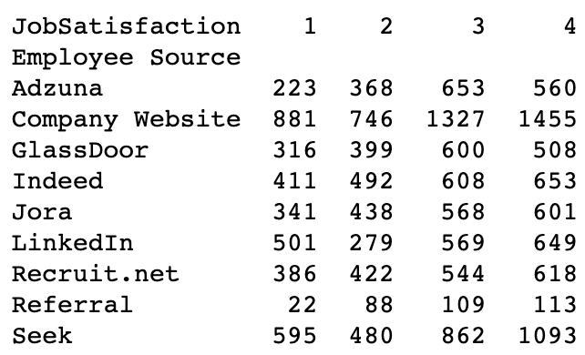
Contingency Tables

Slide 10
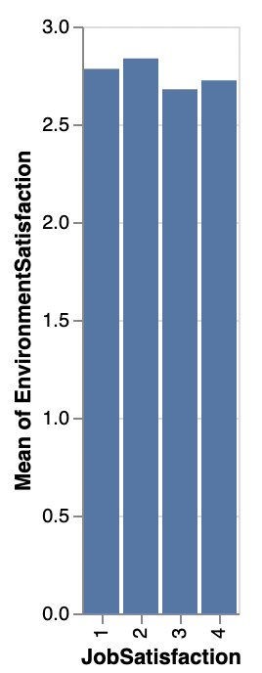
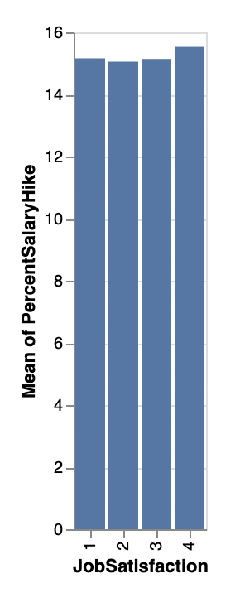
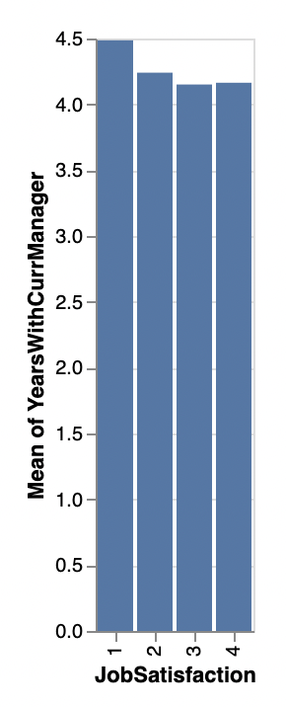
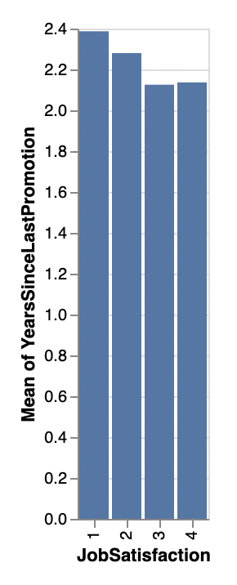
Graphs

Slide 11
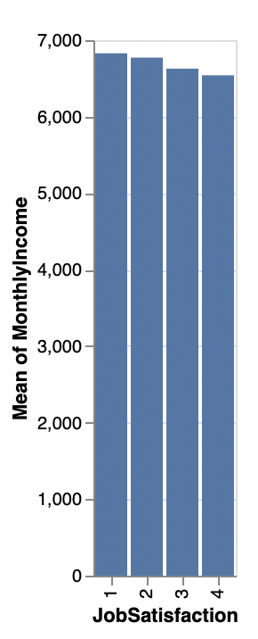
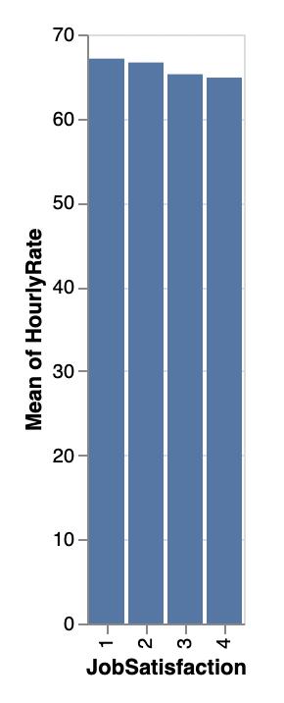
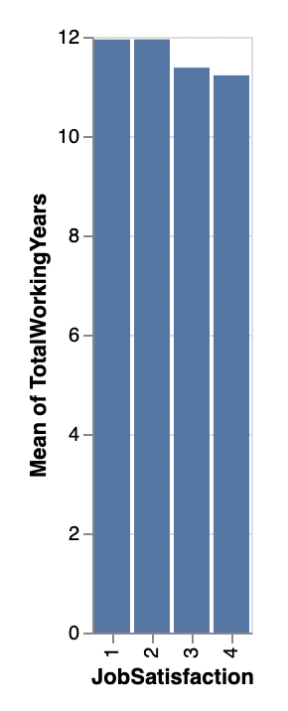
Graphs

Slide 12
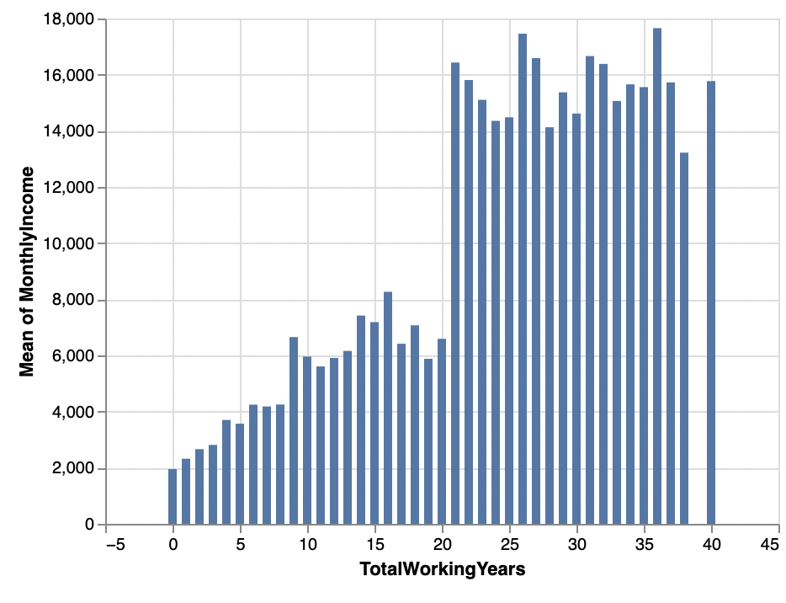
Graphs

Slide 13
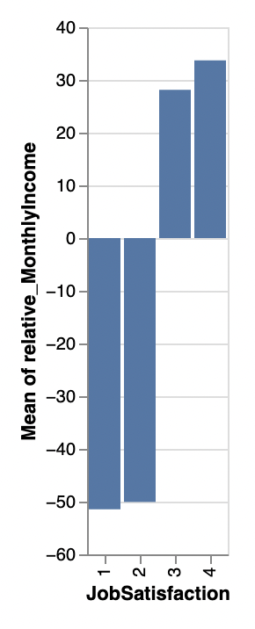
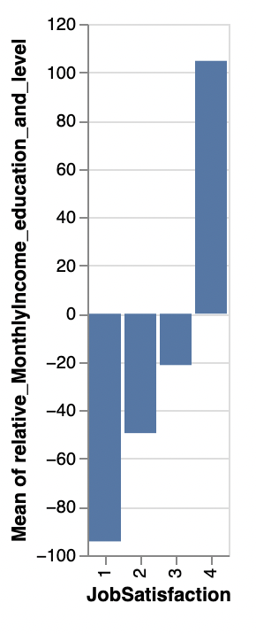
Graphs

Slide 14
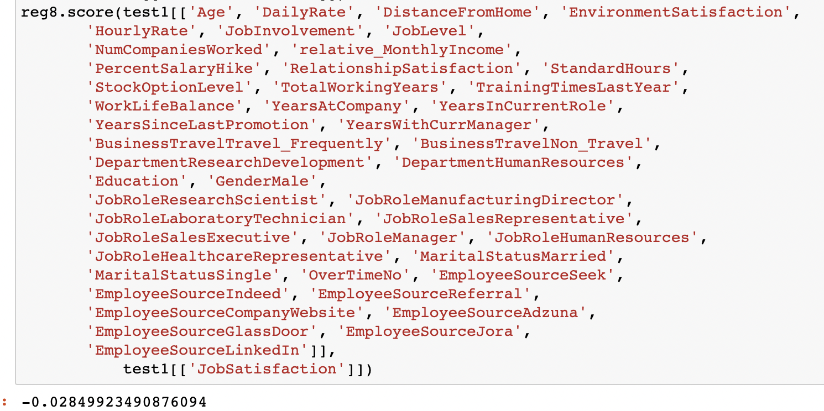
Graphs

Slide 15
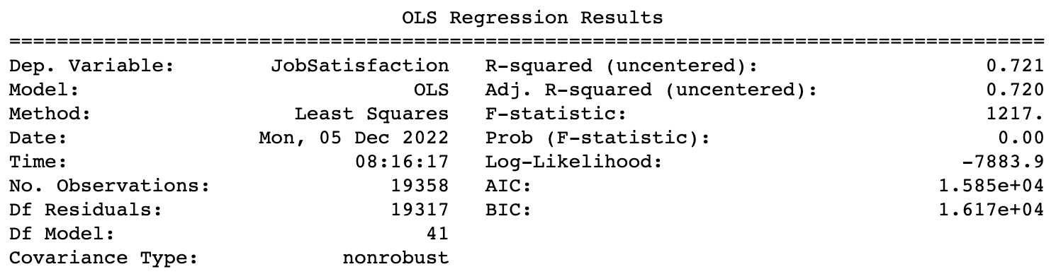

Slide 16
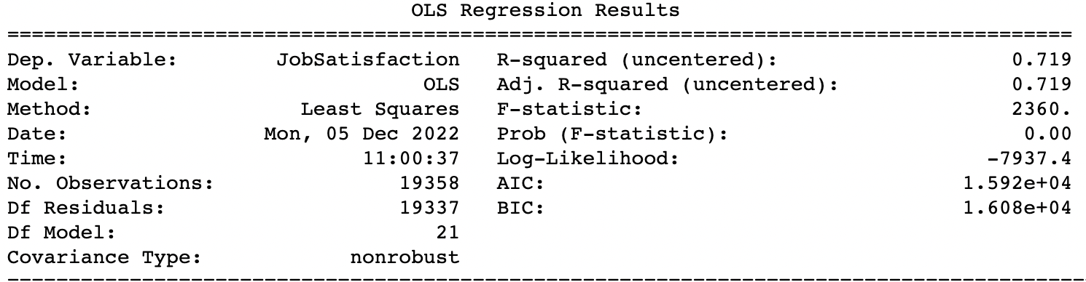


Slide 17
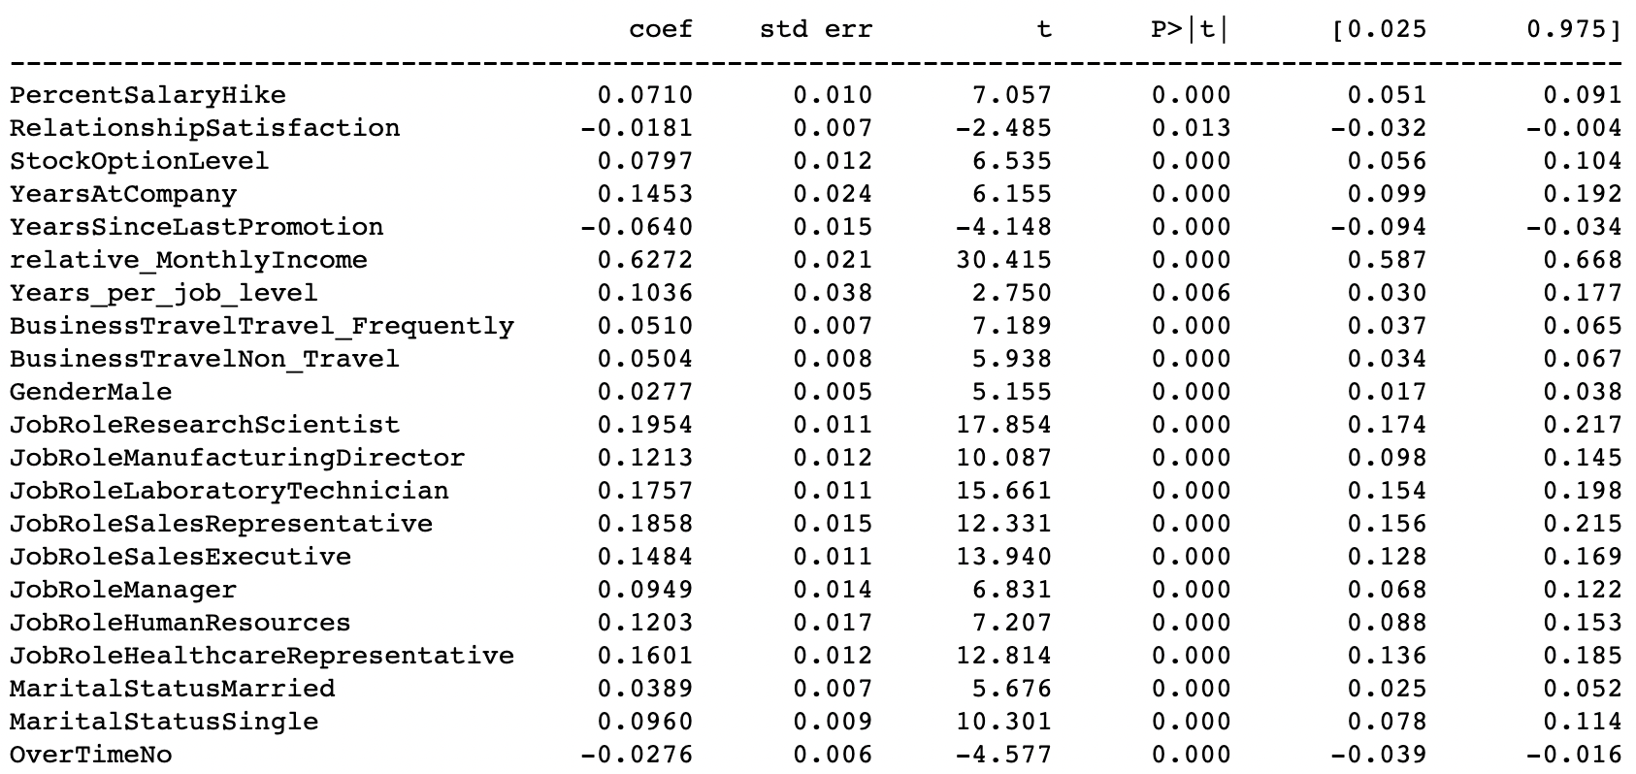





Slide 18
Employee Satisfaction Index

Slide 19
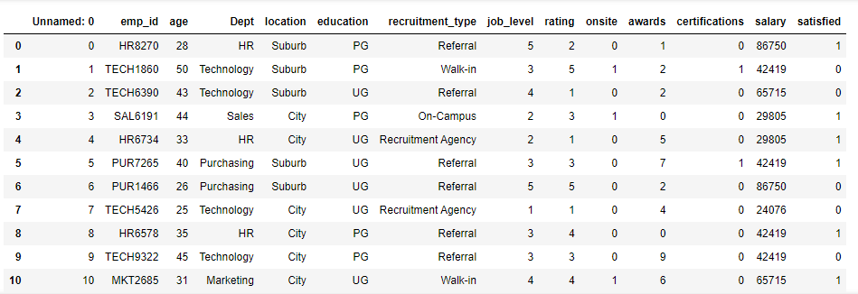
The dataset:

Slide 20
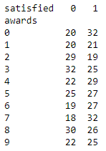
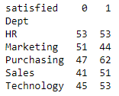
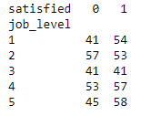





Contingency Tables

Slide 21
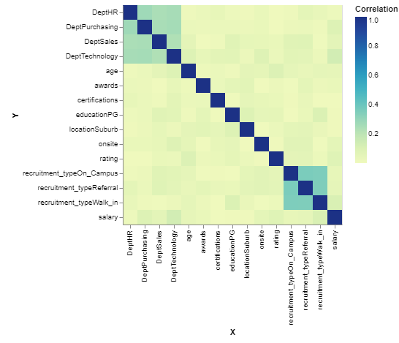
Correlation matrix:

Slide 22
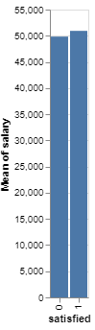
People who are satisfied have, on average, a higher salary.
As expected!

Slide 23
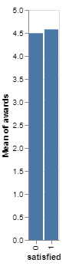
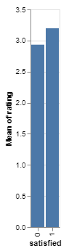
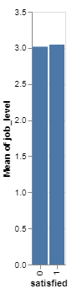

Slide 24
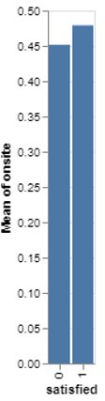
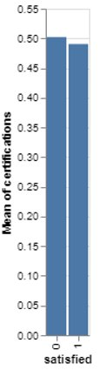
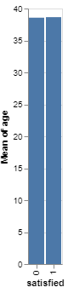

Slide 25
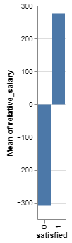
People with a higher salary than their coworkers who are the same age, are more satisfied.

Slide 26
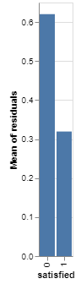
Logistic Regression: R² = 0.552

Slide 27
Survey Results

Slide 28
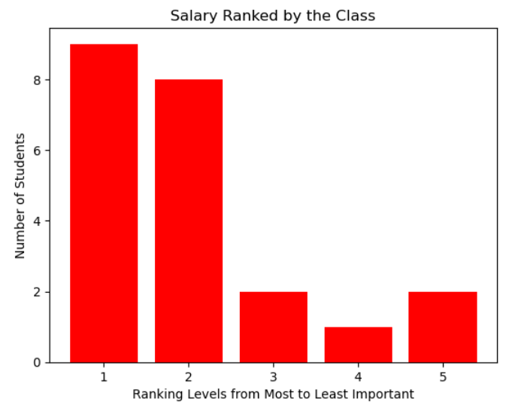
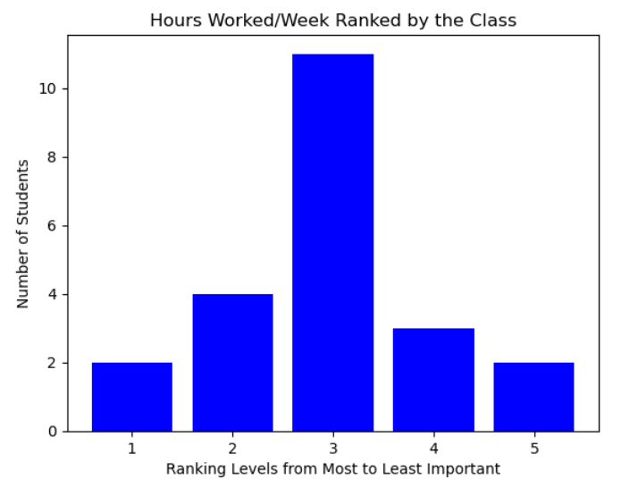
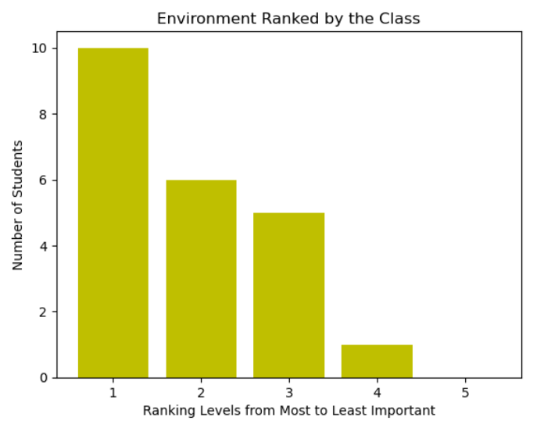
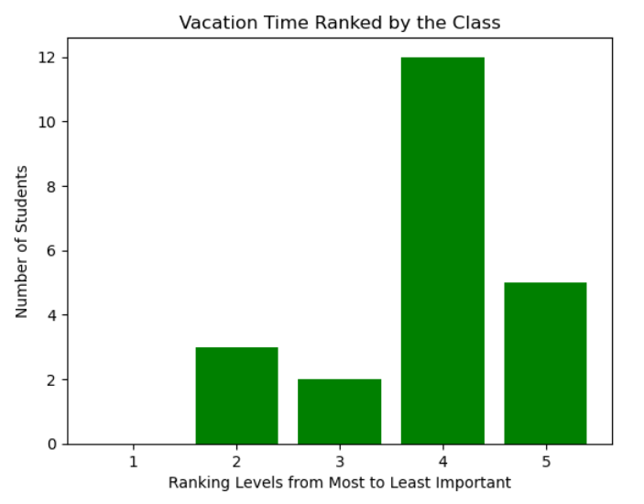
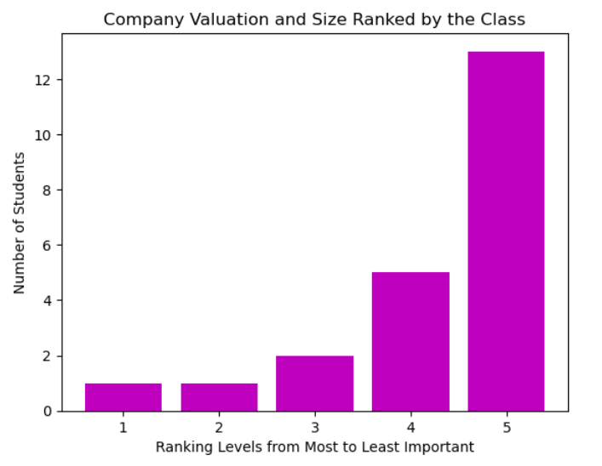
Reminder: The lower the score, the more important the factor!
Average Scores:
Salary: 2.045
Hours Worked/Week: 2.954
Environment: 1.863
Vacation Time: 3.863
Company Valuation and Size: 4.273

Slide 29
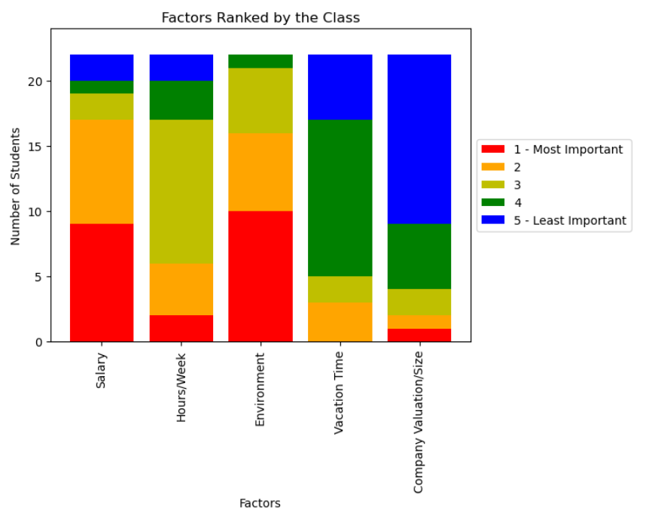
Summary
Environment and Salary are your most important factors
Company Valuation/Size is of least importance to you, followed by Vacation Time

Slide 30
Comparison
Comparing the Class Survey Results to our Results

Slide 31
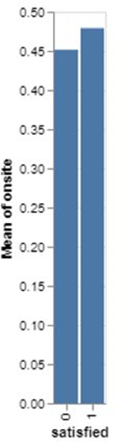
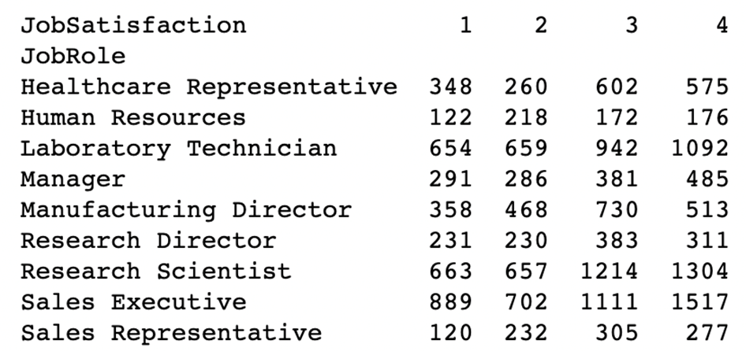
LET’S LOOK AT WHAT OUR DATASETS HAVE TO SAY ABOUT THE FACTORS YOU INDICATED AS THE MOST IMPORTANT
Environment
As shown earlier in the Employee Satisfaction Index, it seems as though people who work onsite are more satisfied with their job!
Salary
No surprise! We saw in both datasets that there is a link between salary and job satisfaction.
However, it’s about more than just the amount of money you make. Both datasets indicate that people who make more money compared to others around their age are more satisfied with their job.
Role
Though role was not a factor we had the class rate, we thought it could be interesting to see if people with roles similar to our possible future roles are satisfied with their jobs!

Slide 32


ROLE JOB SATISFACTION
Let’s take a look at one of our IBM dataset contingency tables… Research Scientist
Laboratory Technician

Slide 33

Does sex have an effect on job satisfaction?

Slide 34
Does sex have an effect on job satisfaction?
Based on the IBM dataset (which used a satisfaction scale of 1 to 4), the average satisfaction rating increases by about 0.03 for male employees.
Male employees are a bit more satisfied.

Slide 35
Summary
IBM
The most important factor influencing job satisfaction is “how much money you are making relative to people your age”.
IBM
Other important (and interesting) factors include your position or role and how long you’ve been working at the company for.
Employee Satisfaction Index
This dataset also showed that in general, the people who are more satisfied with their jobs have a higher salary. It also showed that people who are making more money than their coworkers (who are the same age), are more satisfied.

Slide 36

THANKS!
Any questions?

Slide 37
References
Sypniewska, Barbara, Evaluation of Factors Influencing Job Satisfaction (March 31, 2014). Contemporary Economics, Vol. 8, No. 1, pp. 57-72, 2014, Available at SSRN: https://ssrn.com/abstract=2435040
Bańka, A. (2002). Psychologia organizacji [Psychology of the organization]. In J. Strelau (Ed.), Psychologia. Podręcznik Akademicki [Psychology. Academic Handbook]. (Vol. 3) (pp. 321-350). Gdańsk: GWP.

